Slide 1
DevOps Winter Program 2020-2021 CI/CD Project
Student:
Viacheslav Vasylechko

Slide 2
Task
Automatization to publish web page.
Steps
Create Github repository.
Create instances on AWS.
Install Jenkins.
Install Apache.
Deploy web page from Github to Web server on AWS.

Slide 3





Used OS, platforms and tools.

Slide 4
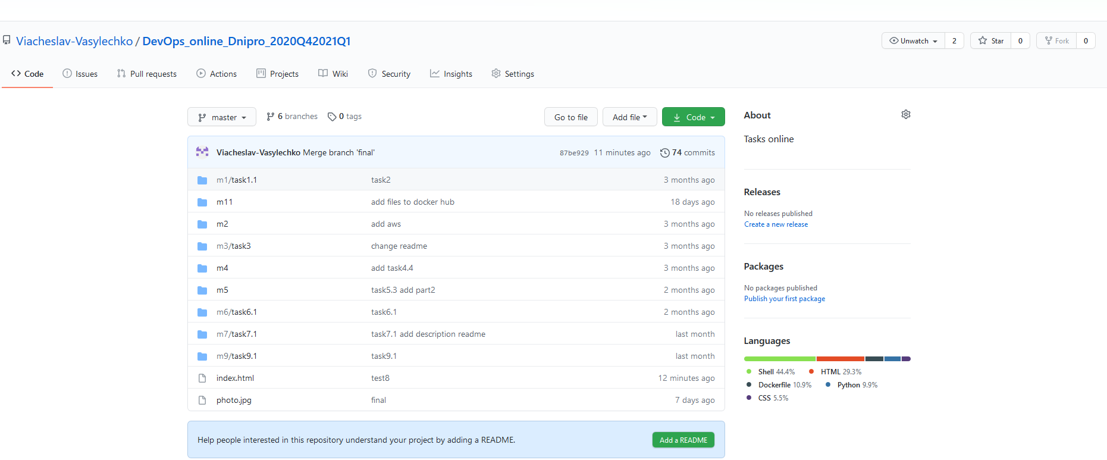

Slide 5
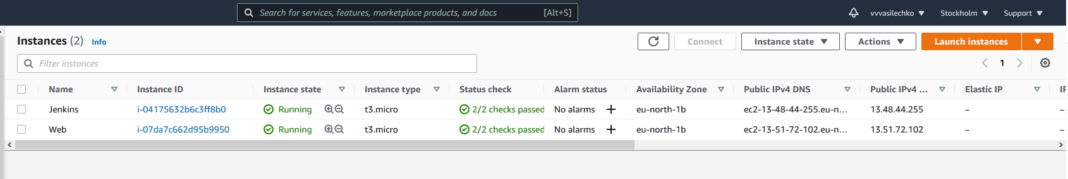
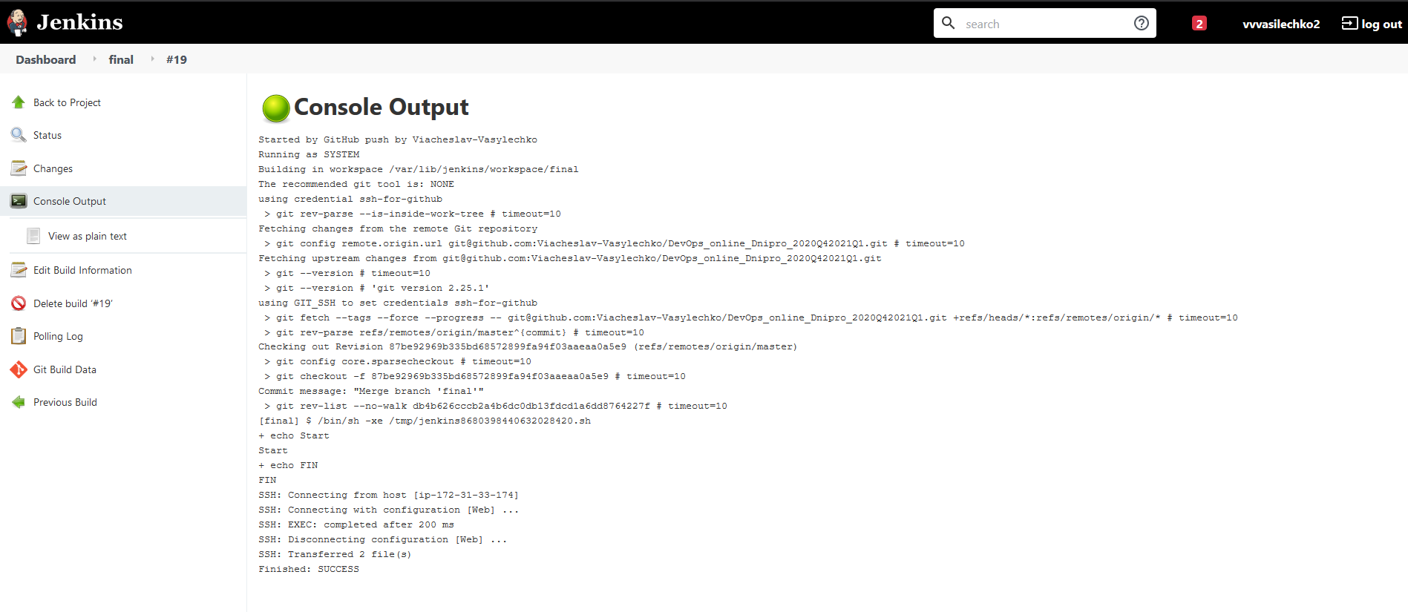

Slide 6
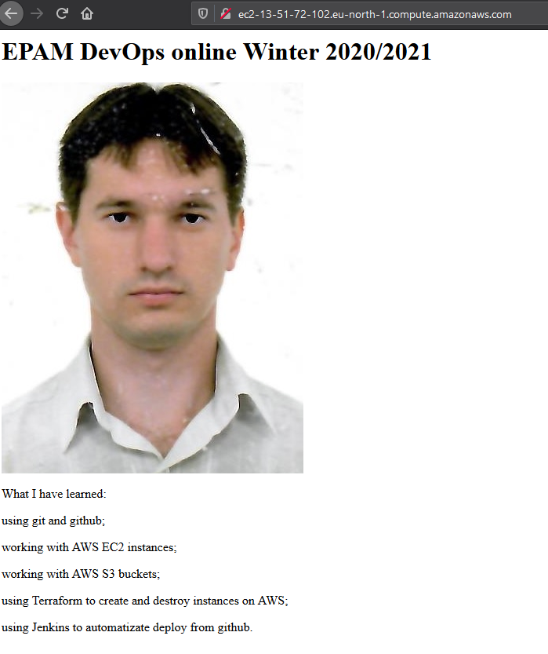

Slide 7
Thanks!
EPAM DevOps winter online 2020/2021
Student: Viacheslav Vasylechko
E-mail: vvvasilechko@gmail.com

